Slide 1
AI-Based Student Performance Analysis and Recommendations
Group Members:
Abdulaziz Mohammed Alduraibi (ID: 444102549)
Sultan Saeed Alqahtani (ID: 444100168)
Instructor:
Dr. Bader Alshemaimri
Course:
SWE485 – Selected Topics in Software Engineering

Slide 2
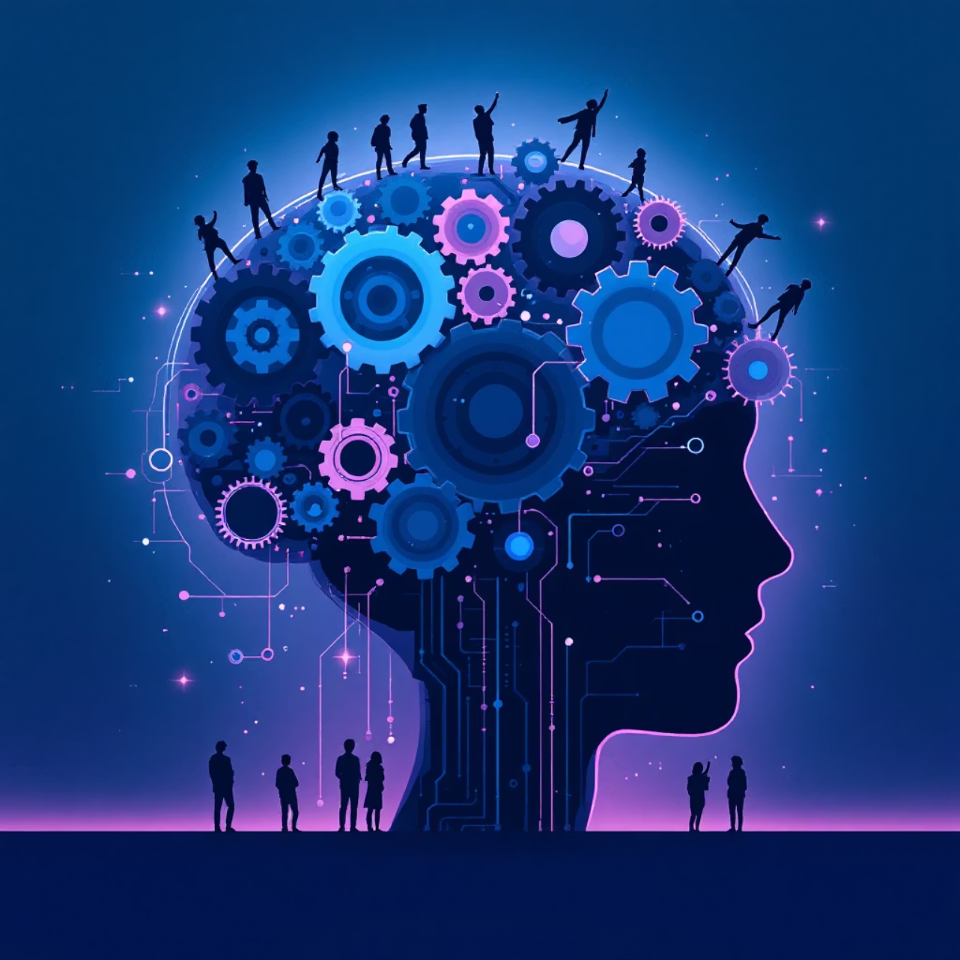
Introduction: Revolutionizing Education with AI
This project introduces an innovative approach to understanding and enhancing student learning through the power of Artificial Intelligence. By leveraging sophisticated Machine Learning algorithms, we aim to transform how academic performance is analyzed and how tailored support can be delivered.
Machine Learning is utilized to deeply analyze student performance data.
Predicts academic outcomes with greater accuracy.
Provides personalized recommendations to improve learning efficiency and engagement.

Slide 3




Comprehensive Dataset for Analysis
Extensive Student Records
Detailed Exam Scores
Each record includes vital academic performance indicators, specifically Math, Reading, and Writing exam scores, providing a holistic view of student capabilities.
Our analysis is built upon a robust dataset comprising 1,000 anonymized student records, ensuring a broad and representative sample for effective machine learning.
Basic Demographic Information
To add context and uncover potential correlations, the dataset also incorporates basic demographic information, allowing for more nuanced analysis.

Slide 4





Project Workflow: From Data to Insight
1. Data Exploration
Initial analysis to understand data structure, identify patterns, and detect anomalies.
2. Supervised Learning
Application of predictive models to forecast academic outcomes based on historical data.
3. Clustering (K-Means)
Grouping students with similar performance characteristics to identify distinct learning profiles.
4. AI Recommendations
Generating personalized, actionable advice to help students improve their academic journey.

Slide 5


Phase 1: Deep Dive into Data Exploration
Our initial phase involved a thorough exploration of the dataset to uncover foundational insights into student performance. This critical step sets the stage for more advanced analytical techniques.
Score distribution analysis: Detailed examination of how scores are spread across Math, Reading, and Writing to identify overall trends and outliers.
Math score challenges observed: Noted a particular concentration of lower scores or significant variance within the Math subject, indicating an area requiring targeted intervention.
Early identification of academic challenges allows for proactive strategy development.

Slide 6




Phase 2: Supervised Learning for Prediction
Multiple ML Models
Comparative Analysis
We employed a variety of supervised learning models, including Regression, Classification, and Decision Trees, to leverage their unique predictive strengths.
The performance of each model was rigorously compared using key metrics like accuracy, precision, recall, and F1-score to determine the most effective predictors.
Predictive Insights
These models enable us to forecast future academic success, identifying students at risk before issues escalate, offering a proactive approach to support.

Slide 7
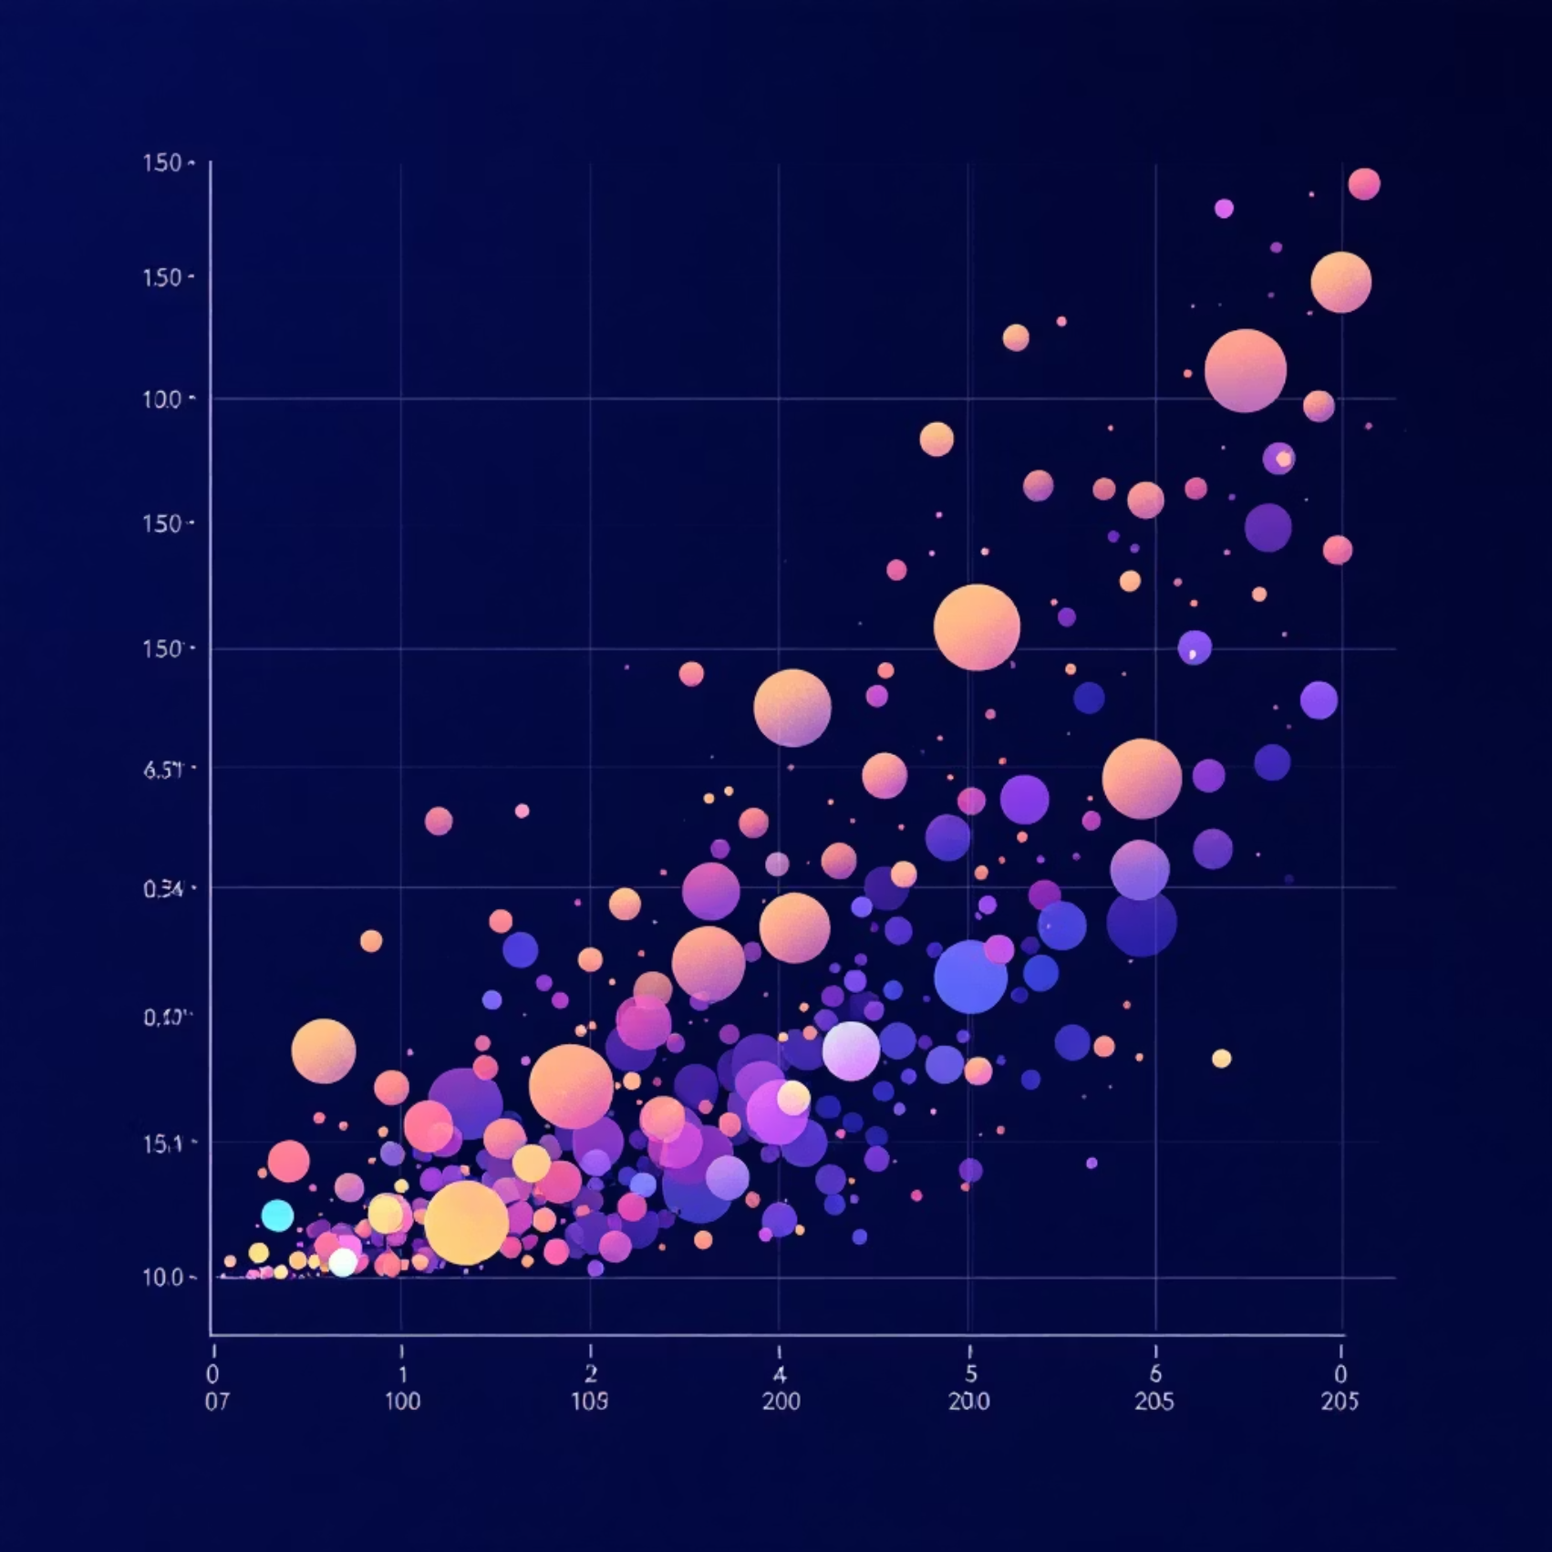
Phase 3: Uncovering Student Archetypes with Clustering
Using the K-Means clustering algorithm, we categorized students into distinct groups based on their performance patterns. This segmentation is crucial for delivering highly targeted interventions.
Three Performance Clusters: Students were grouped into three primary clusters: High-performing, Medium-performing, and Low-performing levels.
Targeted Improvements: Each cluster provides a clear profile, allowing educators to tailor strategies and resources more effectively to specific student needs.

Slide 8




Phase 4: Personalized AI Recommendations
Customized Study Plans
AI generates study recommendations tailored to each student's identified strengths and weaknesses.
Reduce Absences
Suggestions are provided to address attendance issues, recognizing its significant impact on overall performance.
Focus on Weak Subjects
Specific guidance is given to prioritize and reinforce learning in subjects where students consistently underperform.
Optimal Resource Allocation
Recommendations also guide educators on allocating resources, providing additional support where it's most needed.

Slide 9
Conclusion: Empowering Education Through AI
Our AI-based system marks a significant step forward in educational technology, providing tools for both students and educators to achieve academic excellence.
Machine Learning facilitates early intervention, identifying academic risks before they manifest.
Empowers students with personalized learning paths and actionable insights for improvement.
Equips educators with data-driven insights for better decision-making and resource allocation.
Ultimately, it fosters a more responsive and effective learning environment for everyone involved.

Slide 10
Questions & Discussion
Thank You!
We welcome your questions and feedback on our AI-Based Student Performance Analysis and Recommendations project. Your insights are invaluable as we continue to refine and advance this important work.

